Slide 1
CRUD Operations using MongoDB
Sowmya

Slide 2
What is mongo DB?
MongoDB is a popular open-source, NoSQL database management system. It falls under the category of document-oriented databases, meaning it stores data in flexible, JSON-like documents. MongoDB is known for its scalability, performance, and flexibility, making it a popular choice for many modern applications, particularly those that handle large volumes of data or require flexible data models.
Some key features of MongoDB include:
JSON-like Documents: Data in MongoDB is stored in flexible, JSON-like documents, making it easy to work with for developers.
Schema Flexibility: Unlike traditional relational databases, MongoDB does not require a predefined schema, allowing for more flexibility in data modelling and schema evolution.
Scalability: MongoDB is designed to scale out horizontally, allowing for the distribution of data across multiple servers, which helps handle increasing loads and volumes of data.

Slide 3
What was the need of mongo DB although there were many database in action?
All the modern application require big data, fast features development, flexible deployment and older database systems not enough competent, so the mongo DB was obvious needed

Slide 4
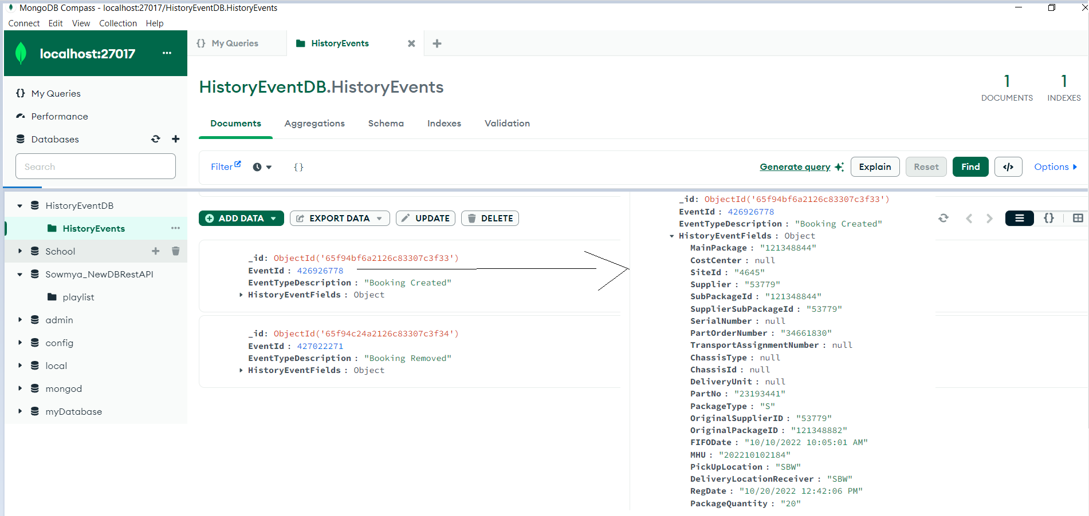

Slide 5
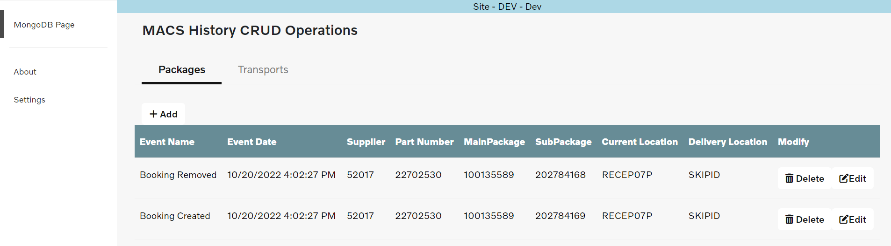

Slide 6
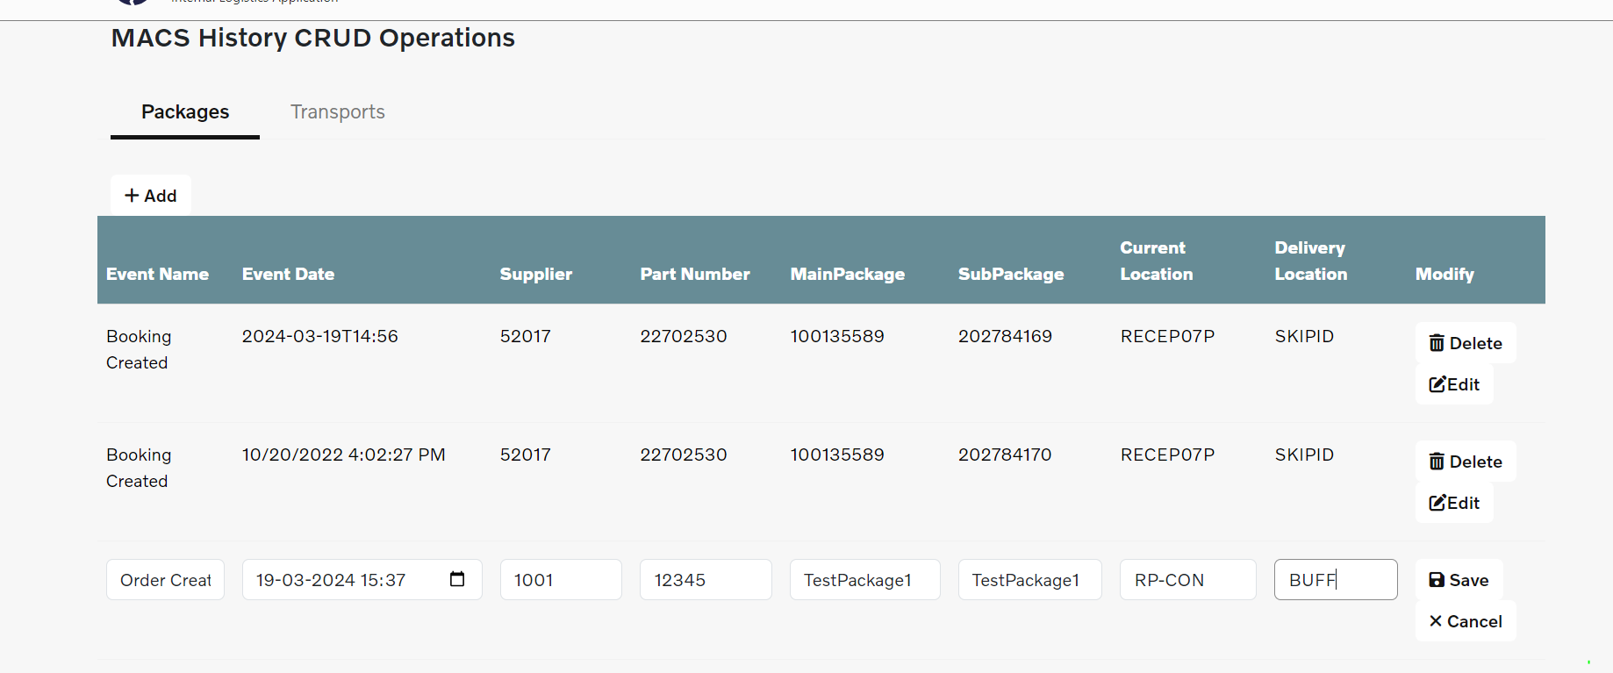

Slide 7
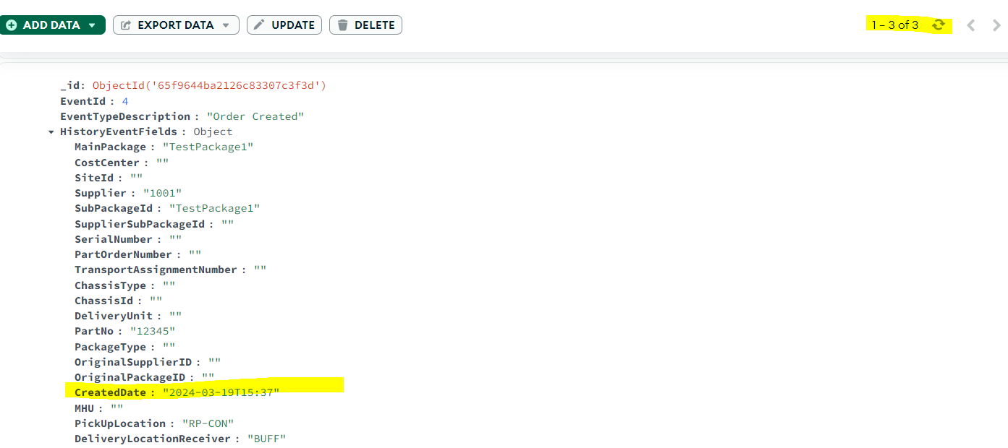

Slide 8
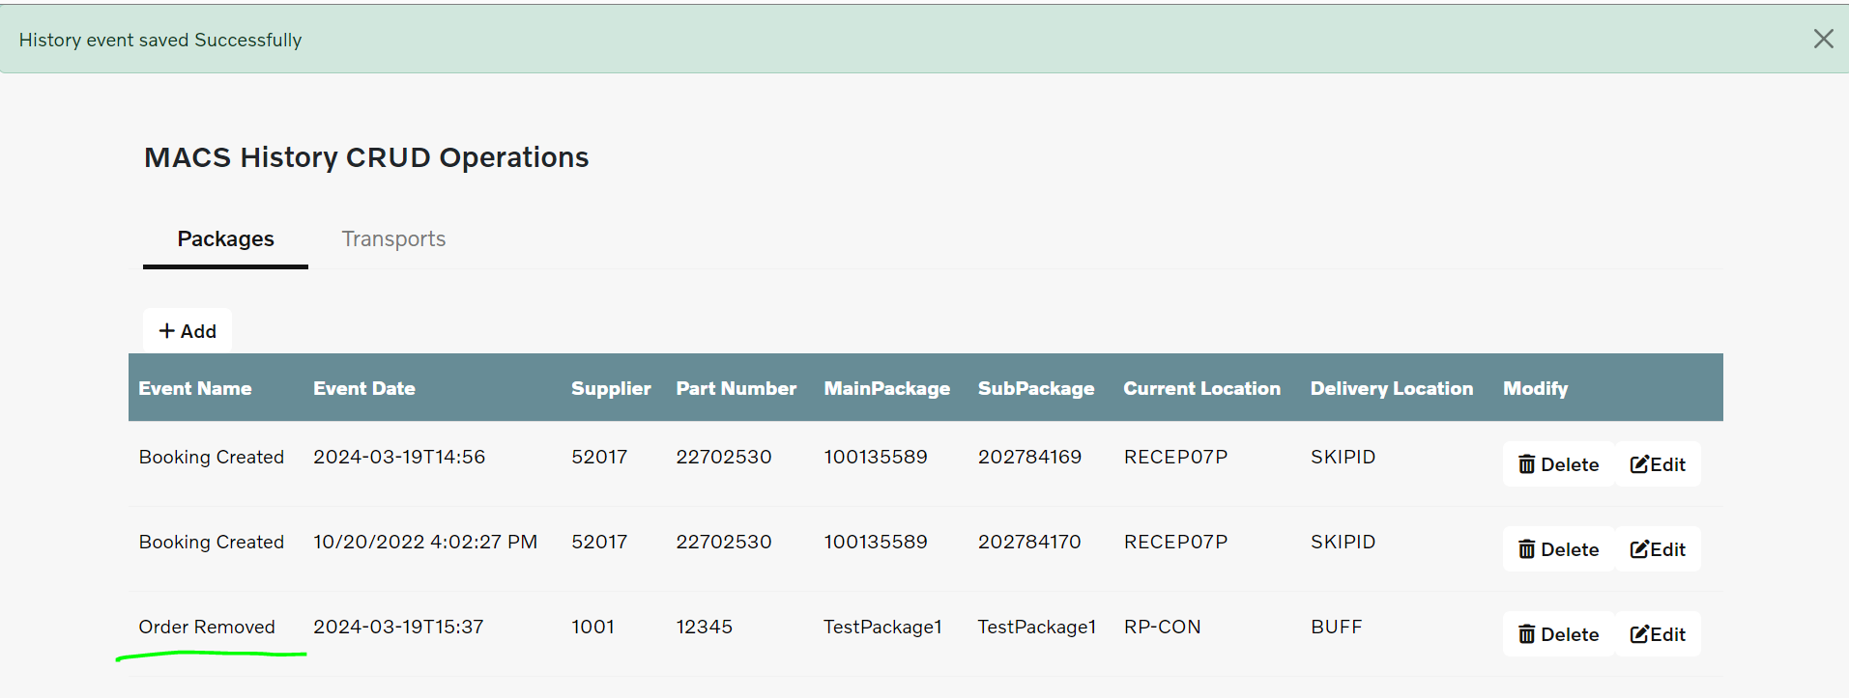

Slide 9
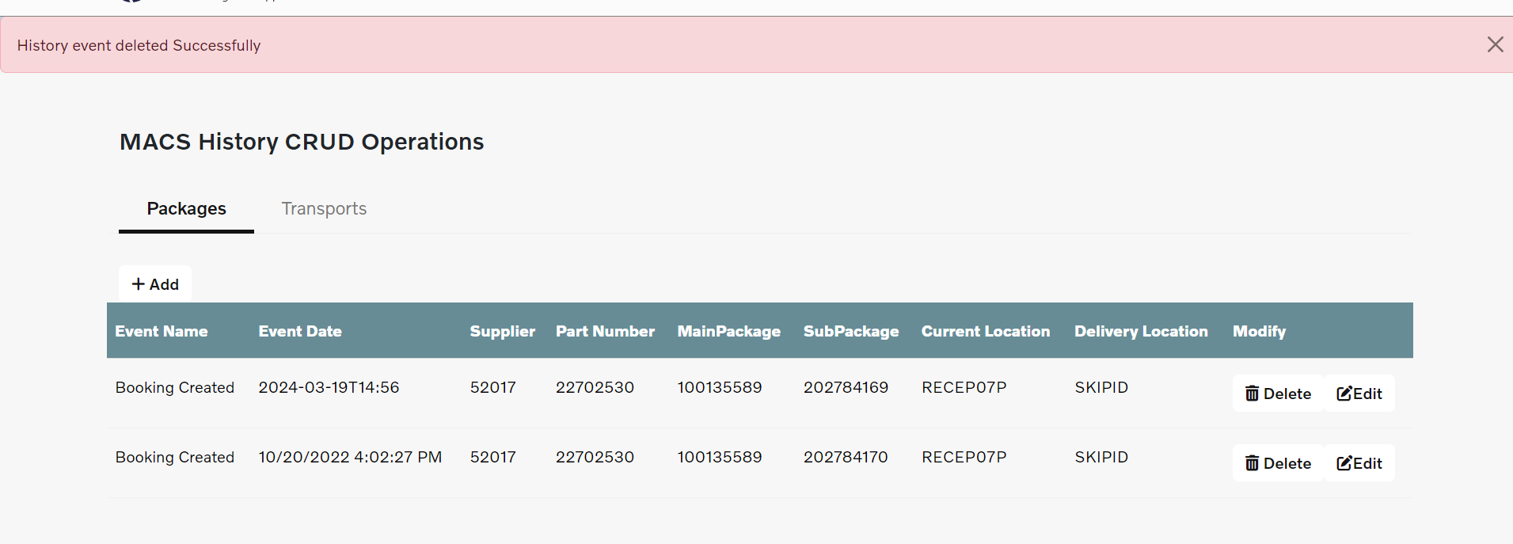

Slide 10
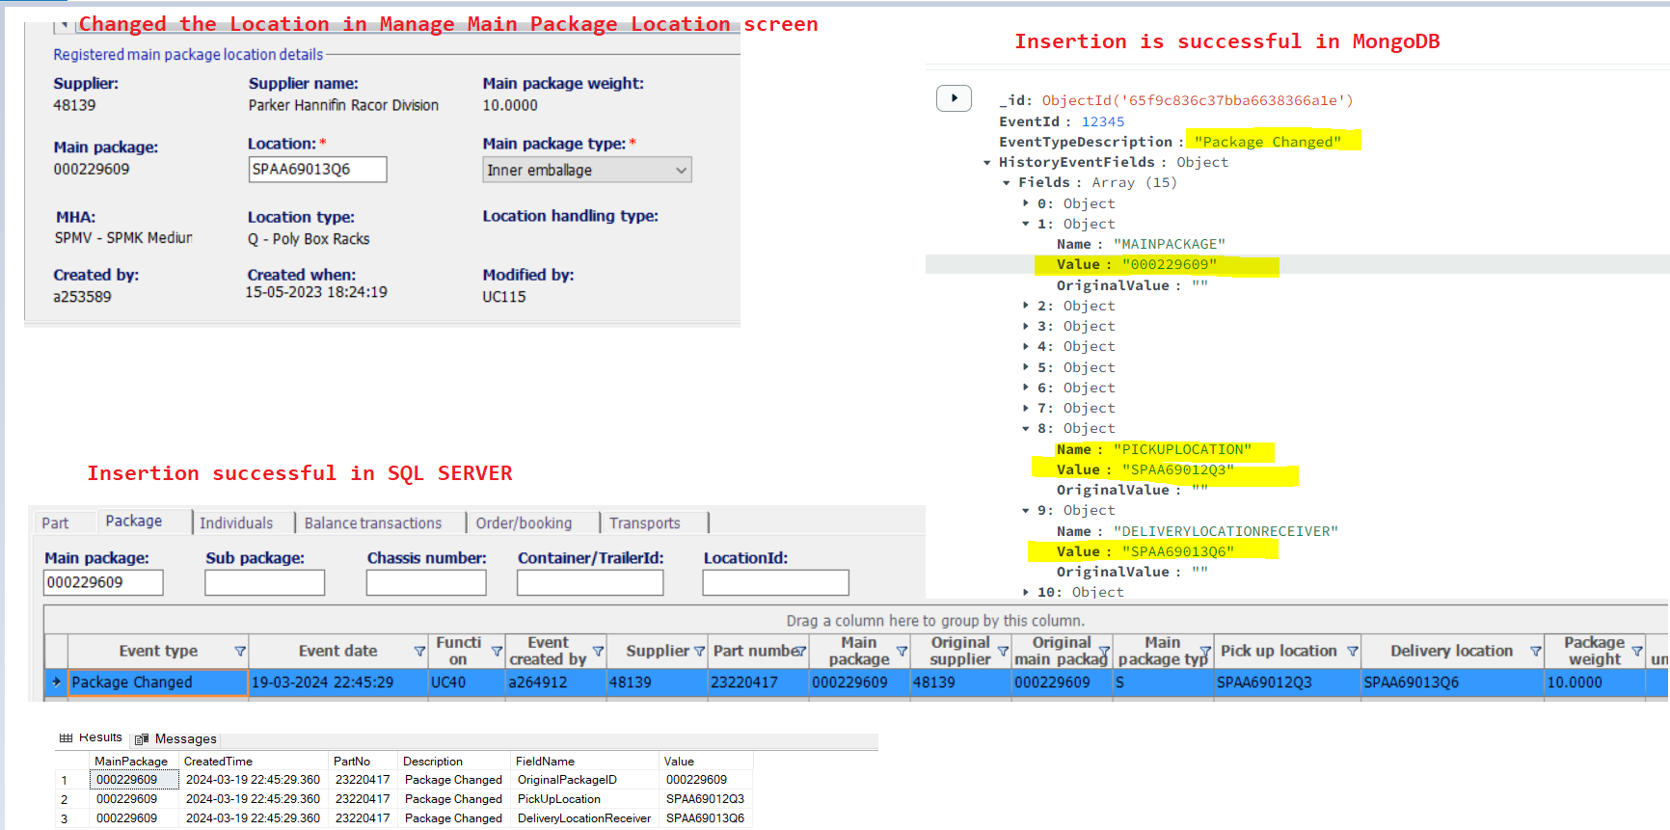
Tried to change the Location of the package so that Package Changed history event gets generated so record/document will get inserted to both SQL Server also MongoDB In summary, MongoDB and SQL Server can coexist within an application, and leveraging the strengths of each database system can help optimize performance, scalability, and data management capabilities based on the specific requirements of your application

Slide 11
Thank You

